Slide 1


Creating Computable Knowledge from Unstructured Information
Cristiana Dinea | NVIDIa
Virginia aDAMS | NVIDIA

Slide 2
AGENDA
Why knowledge extraction?
Baseline implementation
Opportunities for improvements
Conclusion
Next steps

Slide 3
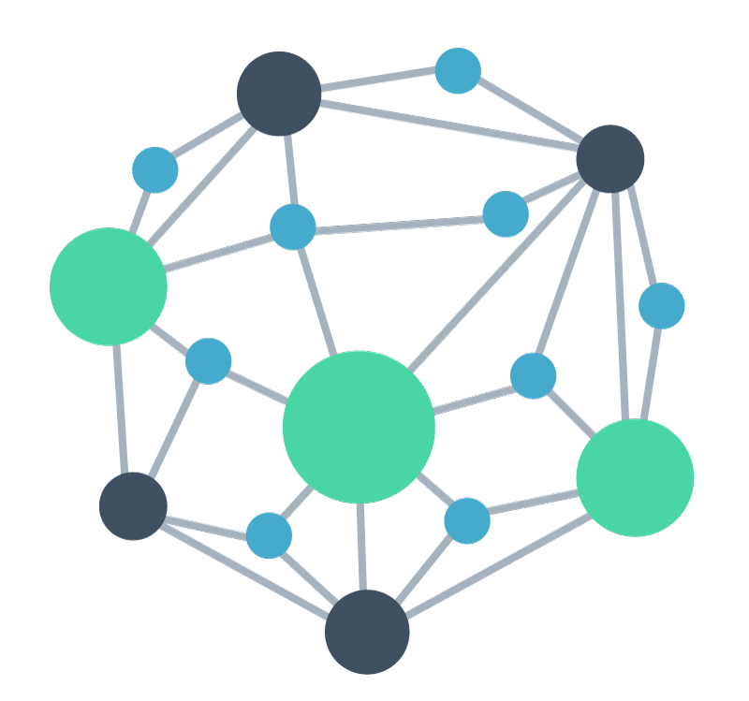


Why knowledge extraction
Creating Computable Knowledge from Unstructured Information
Custom Pre-Trained NLP Models
Extract Entities using Named Entity Recognition
Co-Reference Resolution, Negative Detection
Biomedical literature
Knowledge graph population, Querying
Relation Extraction
Relationship Canonicalization
Entity Linking to an Ontology
Trials data
Knowledge Graph Population
Semantic search applications, Ranker/Retriever
Integrated Information Retrieval and Search
Notes:
A typical knowledge extraction pipeline proceeds in a stepwise fashion, first by ingesting datasets of interest, then extracting entities of particular interest – such as a disease, a diagnosis, a test, a drug, or an intervention – then understanding how those entities are related to each other. For example, we might consider that a particular drug can be understood to be contraindicated with another drug, interact with a particular protein or biological pathway, or typically lead to a certain set of side effects. Importantly, these entities and relations can be richly described in English and any other language, and so variations in their representations in free text information present a challenge if we are to link the assembled knowledge from our document sources together. Entity linking, where we define a particular schema or ontology and discover the relationships between the free text representation of an idea to a particular reference entity defined in an ontology. An example of this might be myocardial infarction and heart attack, two ways of representing the same concept depending on the level of technical jargon and detail provided in a document.
Finally, the extracted entities, relationships, and fixed representations linked to an ontology can power a variety of downstream applications, including populating and querying knowledge graph databases, or implementing semantic search applications over your data.

Slide 4
Baseline implementation

Slide 5
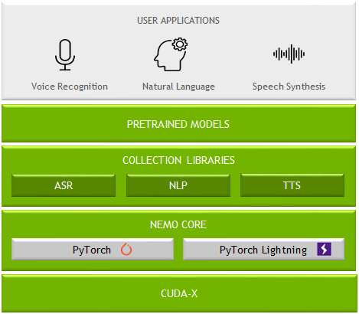
NVIDIA NEMO
Toolkit for Building SOTA Conversational Models
DL-Based Speech & Language Understanding Models
Include Semantic Checking for Correct-by-Construction Architectures
Support Expanding Set of Languages:
8 for ASR
5 for NLU
Open-Sourced
Integrated with PyTorch & PyTorch Lightning
Easy-to-Use APIs
Optimized Training Performance
100+ Pre-Trained GPU-Optimized Checkpoints
Scale to 1000s of NVIDIA GPUs
https://ngc.nvidia.com/catalog/containers/nvidia:nemo
https://github.com/NVIDIA/NeMo
Notes:
NVIDIA NeMo is NVIDIA’s open-source research-grade framework and toolkit for building state of the art conversational AI models, including for applications natural language understanding like biomedical and clinical BERT classification tasks. Although today we are focused on text, for those interested, NeMo provides state-of-the-art automatic speech recognition technologies out of the box, important for many of the transcription, telehealth, and call center applications that we discussed at the very beginning of this presentation.
NeMo makes it easy to start from a pre-trained checkpoint, pull a configuration for a particular downstream task implementing modern best practices for fine-tuning, point the model at your fine-tuning dataset, and benchmark/investigate and tune performance all within a framework that will be familiar to pytorch and pytorch-lightning users. Under the hood, NeMo implements several performance optimizations for training BERT models, including automatic mixed precision support and distributed multi-node multi-gpu support.
The NeMo collections library is extensive, and even interopates with HuggingFace. The NLP collection hosted on NGC contains several Biomegatron models, which is where we will start our investigation of Named Entity Recognition, Relation Extraction, and Entity Linking.

Slide 6
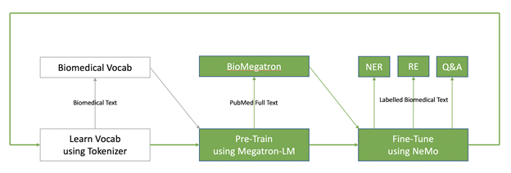
BioMegatron
State-of-the-Art Biomedical Pre-Trained Transformer Models
Largest biomedical language model trained (345M, 800M, 1.2B parameter variants)
Pre-trained from scratch on 6.1B words from PubMed
Using scientific biomedical vocabulary
Straightforward fine-tuning with NVIDIA NeMo for NER, RE, or Q&A tasks
Notes:
NVIDIA has recently applied Megatron BERT pre-training to both biomedical and clinical text. In 2020 we released BioMegatron, a free and open source set of pre-trained checkpoints for biomedical classification tasks. This model remains today among the most popular pre-trained models we have built for the community. It was trained on 6.1B words from the permissively licensed portion of PubMed using a custom domain-specific biomedical vocabulary. BioMegatron is available out of the box in NVIDIA NeMo for downstream task-specific fine-tuning, which we will cover later in the presentation.

Slide 7
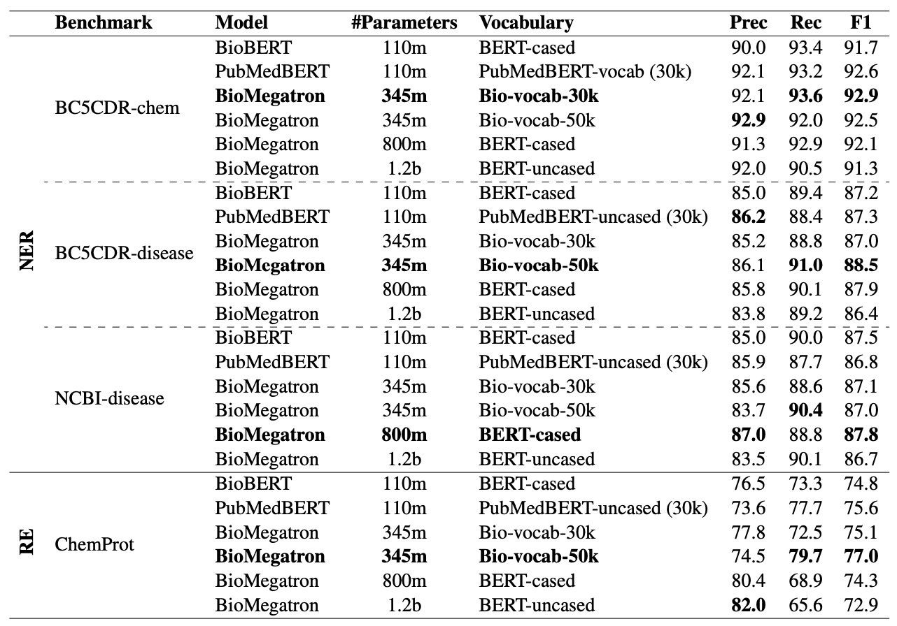
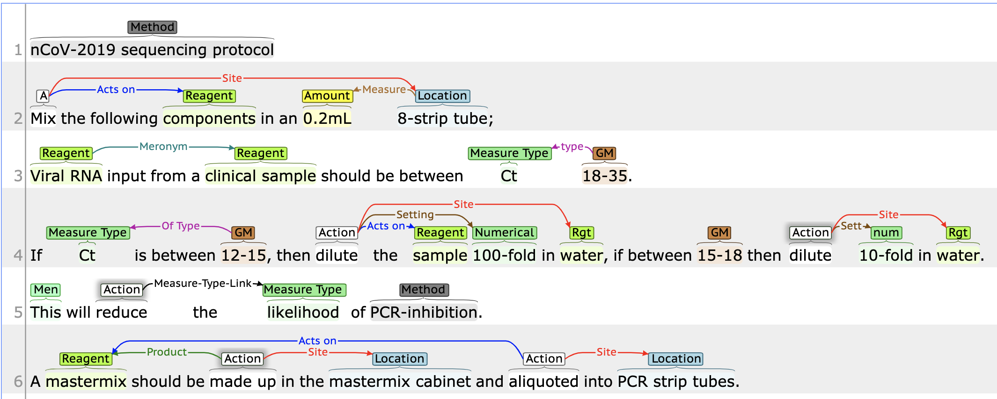
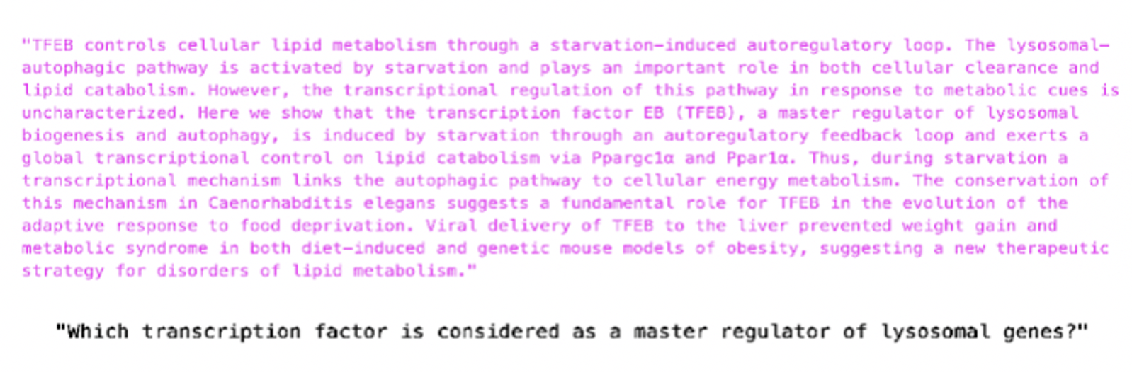
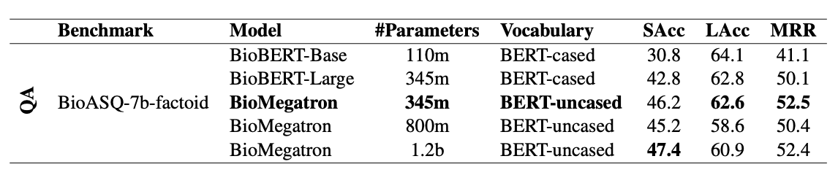
SOTA biomedical NLP breakthroughs
BioMegatron Achieves State-of-the-Art
Named
Entity
Recognition
Relation
Extraction
Question
Answering
Shin, H.-C. et al. BioMegatron: Larger Biomedical Domain Language Model. arXiv [cs.CL] (2020)
Notes:
We benchmarked named entity recognition, relation extraction, and extractive question answering using BioMegatron fine-tuned using canonical benchmarks in the field, including BC5CDR-chem, a dataset from the BioCreative V challenge that consists of labeled diseases, chemicals and their relationships; ChemProt, a dataset of almost 2000 annotated PubMed articles with both chemical-protein itneractions annotated by domain expects from the BioCreate VI challenge, and BioAsk factoid, a dataset containing training and test biomedical questions along with gold standard answers.
----
Task 7b will use benchmark datasets containing training and test biomedical questions, in English, along with gold standard (reference) answers. The participants will have to respond to each test question with relevant concepts (from designated terminologies and ontologies), relevant articles (in English, from designated article repositories), relevant snippets (from the relevant articles), relevant RDF triples (from designated ontologies), exact answers (e.g., named entities in the case of factoid questions) and 'ideal' answers (English paragraph-sized summaries). 2747 training questions (that were used as dry-run or test questions in previous year) are already available, along with their gold standard answers (relevant concepts, articles, snippets, exact answers, summaries). At least 500 new test questions will be used this year. All the questions are constructed by biomedical experts from around Europe.
BC5-chem; The corpus consists of three separate sets of articles with diseases, chemicals and their relations annotated. The training (500 articles) and development (500 articles) sets were released to task participants in advance to support text-mining method development. The test set (500 articles) was used for final system performance evaluation.
ChemProt BC6; Consists of 1,820 PubMed abstracts with chemical-protein interactions annotated by domain experts and was used in the BioCreative VI text mining chemical-protein interactions shared task.
F1 – Measures average overlap between prediction and ground truth
Sacc – strict accuracy, exact match of strings between predictions and gold standard answers. Top 1 exact answers.
Lacc – rate of exact answers in top 5 predictions
MRR – mean reciprocal rank, mean rank on the top 5 answers.

Slide 8
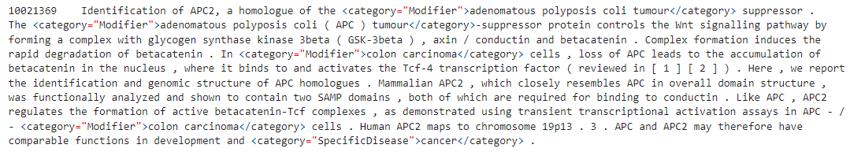
Named entity recognition (NER)
BioMegatron Fine-Tuning for Disease Extraction from NCBI-Disease Corpus
Starting from BioMegatron pre-trained checkpoint, fine-tune the model to extract and label specific entity types related to disease, as defined in the NCBI-Disease corpus.
NCBI disease includes 793 PubMed abstracts annotated by expert human labelers given a defined number of entity classes to extract. These may be related to a standard ontology, or one designed for a specific task.
Reference implementation in NVIDIA NeMo achieves 98.8% weighted average F1 score after <20 minutes of fine-tuning on a NVIDIA V100 GPU.
Dataset can be converted into standard IOB tagging format with standard pre-processing tools distributed with NeMo.
Notes:
For Named Entity Recognition, we will start from a standard public dataset from the National Center for Biotechnology Information (NCBI), a set of PubMed abstracts annotated by expert labelers that contains specific entity types related to disease. It is distributed in a standard HTML format which can be easily converted into standard IOB tagging using tools distributed with NeMo. An out of the box pipeline in NeMo is available, including an NER TextClassification task and reference configuration demonstrated in a Jupyter notebook and accessible through our NGC NeMo container. It achieves nearly 99% weighted F1 accuracy on this task after fine-tuning for less than 20 minutes on an NVIDIA V100 GPU, as a baseline reference.

Slide 9

Relation Extraction (RE)
BioMegatron Fine-Tuning to Extract Entity Relations from CHEMPROT Chemical-Protein Interaction Database
Starting from BioMegatron pre-trained checkpoint, fine-tune the model to perform a sentence classification task to classify the relationship between an identified Gene and Chemical. For example, “upregulates”, “downregulates”, “agonist”, “antagonist”, or “product of”.
Reference implementation in NVIDIA NeMo achieves 89.5% weighted average F1 score after 30 minutes of fine-tuning on a NVIDIA V100 GPU.
Notes:
For our demo of biomedical relation extraction, we focus on the ChemProt from the BioCreative 6 challenge, which consists of about 1800 PubMed abstracts with chemical-protein interactions annotated by a domain expert. Starting from a BioMegatron pre-trained checkpoint, our reference implementation in a Jupyter notebook distributed with NeMo and available in the NeMo NGC container and on our open source Github repository, performs a multi-label classification task for each of 5 defined relationships between entities and achieved a weighted average F1 score of about 90% after 30 minutes of fine-tuning on an NVIDIA A100 GPU.

Slide 10
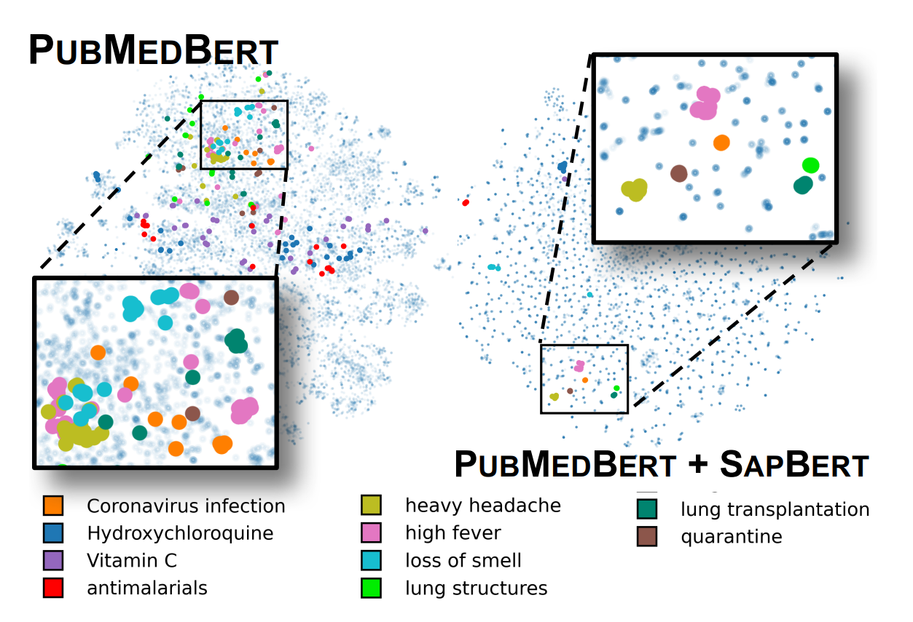
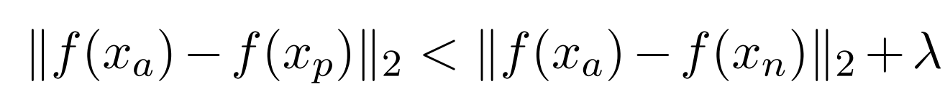
Self-alignment pre-training
Generate embedding representations clustered directly for entity linking in UMLS
End-to-End Medical Entity Linking
Goal is to design a novel objective that clusters synonyms of the same concept
Hard positive pairs have the same entity ID but are farther away from each other in vector space than the closest negative pair by some margin
Pairwise cosine similarity of BERT-based representations, adopt a multi-similarity loss within each mini-batch
Liu, F., Shareghi, E., Meng, Z., Basaldella, M. & Collier, N. Self-Alignment Pretraining for Biomedical Entity Representations. arXiv [cs.CL] (2020)
Notes:
The general idea is to coax the model to align like synonyms in the embedding space, such that, as an example, all relevant synonyms for Coronavirus infection (for example Vitamin C, ascorbic acid, one of dozens of brand names for supplements if desired), are clustered and can therefore be easily extracted with the entity ID. The technique can be applied to any arbitrary BERT model, such as PubMedBERT or BioMegatron. The idea behind self-alignment pre-training combines sampling “hard pairs”, that is, those entities which have the same entity ID but are far away from each other in the embedding space. A multi-similarity loss is then used to coax each mini-batch to align those pairs in the embeddings.
LitCoin challenge:
Joint sponsorship from the National Center for Advancing Translational Sciences (NCATS), the National Center for BioTechnology Information (NCBI), and the NASA Tournament Lab.
Explicit goal to improve linkages and maps relating scientific discoveries in literature, targeting knowledge graphs and open data repositories used to identify gaps and accelerate medical/biomedical research.
Two parts
Phase 1: November 9, 2021 – December 23, 2021
Given an abstract, find all nodes (biomedical entities) corresponding to a BioLink Model category (extensive python library support here).
NER + link to concept ontology, uniquely identified as one and only one of
DiseaseOrPhenotypicFeature, ChemicalEntity, OrganismTaxon, GeneOrGeneProduct, SequenceVariant, CellLine
Provided training dataset of abstracts (including metadata, PubMed ID, title), entities (structured as offset begin/end positions, types, ontology linkages)
Ontology linkages (used in Phase 2) from NCBI Gene, MEDIC (MESH + OMIM), MESH, RS# in dbSNP, NCBI Taxonomy, and Cellosaurus for each of the types indicated above, respectively.
Phase 2: December 27, 2021 – February 28, 2022
Given an abstract and extracted nodes, find all relationships between nodes corresponding to a BioLink Model Predicate.

Slide 11
Walkthrough notebooks
AWS setup
X-lab setup
Walkthrough ner re el

Slide 12
Opportunities for improvements

Slide 13
RE score
Model ensemble
Data shuffle
Different approach –Virginia , p tuning

Slide 14
conclusion

Slide 15
Next steps

Slide 16
NVIDIA CONFIDENTIAL SLide
Optional Subtitle
Bullet text (if bullet symbol is not needed, turn to “None” on “Home” tab in “Paragraph” styles)
Secondary bullet text
Use 40 pt. Trebuchet font
Keep points short and informative
Example of highlighted text

Slide 17
Two column layout
Optional Subtitle
Text goes here
Text goes here
Text goes here
Text goes here
Text goes here
Text goes here
Text goes here
Text goes here
Text goes here
Text goes here

Slide 18
NVIDIA Two column confidential slide
Optional Subtitle
Text goes here
Text goes here
Text goes here
Text goes here
Text goes here
Text goes here
Text goes here
Text goes here
Text goes here
Text goes here

Slide 19
Coding title
Coding Subtitle
Bullet text (if bullet symbol is not needed, turn to “None” on “Home” tab in “Paragraph” styles)
Secondary bullet text
Use 40 pt. Trebuchet font
Keep points short and informative
Example of highlighted text

Slide 20
NVIDIA CONFIDENTIAL SLIDE
Coding Slide
Bullet text (if bullet symbol is not needed, turn to “None” on “Home” tab in “Paragraph” styles)
Secondary bullet text
Use 40 pt. Trebuchet font
Keep points short and informative
Example of highlighted text

Slide 21
“Quote example. Trebuchet 100 pt. Use with shorter quotes.”
Quote Source, Trebuchet 40 pt.

Slide 22
Color palette
Black
0 / 0 / 0
Light Gray
205 / 205 / 205
Primary and
Neutral Colors
NVIDIA Green
RGB: 118 / 185 / 0
Medium Gray
140 / 140 / 140
Dark Gray
94 / 94 / 94
Secondary
Colors
Emerald
0 / 133 / 100
Amethyst
93 / 22 / 130
CPU Blue
0 / 113 / 197
Garnet
137 / 12 / 88
Fluorite
250 / 194 / 0

Slide 23
Pie chart
Source: Source information is 24 pt, italic

Slide 24
bar chart
Y-axis text goes here
X-axis text goes here
Source: Source information is 24 pt, italic

Slide 25


line chart
NOTE: Link All Original Data for Charts
Y-axis text goes here
X-axis text goes here
Source: Source information is 24 pt, italic

Slide 26
Table sample
 | Title Goes Here | Title Goes Here | Title Goes Here
Text Goes Here | Text
Text Goes Here
Text Goes Here
Text Goes Here
Text Goes Here

Slide 27
Transition slide or section divider

Slide 28
1 panel layout
Optional Subtitle
Image title goes here
Optional Subtitle

Slide 29
2 panel layout
Optional Subtitle
Image title goes here
Image title goes here
Optional Subtitle
Optional Subtitle

Slide 30
2 panel alternate layout
Optional Subtitle
Image title goes here
Image title goes here
Optional Subtitle
Optional Subtitle

Slide 31
3 panel layout
Optional Subtitle
Image title goes here
Image title goes here
Image title goes here
Optional Subtitle
Optional Subtitle
Optional Subtitle

Slide 32
4 panel layout
Optional Subtitle
Image title goes here
Image title goes here
Image title goes here
Image title goes here
Optional Subtitle
Optional Subtitle
Optional Subtitle
Optional Subtitle

Slide 33
4 panel alternate layout
Optional Subtitle
Image title goes here
Image title goes here
Image title goes here
Image title goes here
Optional Subtitle
Optional Subtitle
Optional Subtitle
Optional Subtitle

Slide 34
5 panel layout
Optional Subtitle
Image title goes here
Image title goes here
Image title goes here
Optional Subtitle
Optional Subtitle
Optional Subtitle
Image title goes here
Image title goes here
Optional Subtitle
Optional Subtitle

Slide 35
6 panel layout
Optional Subtitle
Image title goes here
Image title goes here
Image title goes here
Optional Subtitle
Optional Subtitle
Optional Subtitle
Image title goes here
Image title goes here
Image title goes here
Optional Subtitle
Optional Subtitle
Optional Subtitle

Slide 36
7 panel layout
Optional Subtitle
Image title goes here
Image title goes here
Image title goes here
Image title goes here
Optional Subtitle
Optional Subtitle
Optional Subtitle
Optional Subtitle
Image title goes here
Image title goes here
Image title goes here
Optional Subtitle
Optional Subtitle
Optional Subtitle

Slide 37
8 panel layout
Optional Subtitle
Image title goes here
Image title goes here
Image title goes here
Image title goes here
Optional Subtitle
Optional Subtitle
Optional Subtitle
Optional Subtitle
Image title goes here
Image title goes here
Image title goes here
Image title goes here
Optional Subtitle
Optional Subtitle
Optional Subtitle
Optional Subtitle

Slide 38
9 panel layout
Optional Subtitle
Image title goes here
Image title goes here
Image title goes here
Image title goes here
Image title goes here
Optional Subtitle
Optional Subtitle
Optional Subtitle
Optional Subtitle
Optional Subtitle
Image title goes here
Image title goes here
Image title goes here
Image title goes here
Optional Subtitle
Optional Subtitle
Optional Subtitle
Optional Subtitle

Slide 39
10 panel layout
Optional Subtitle
Image title goes here
Image title goes here
Image title goes here
Image title goes here
Image title goes here
Optional Subtitle
Optional Subtitle
Optional Subtitle
Optional Subtitle
Optional Subtitle
Image title goes here
Image title goes here
Image title goes here
Image title goes here
Image title goes here
Optional Subtitle
Optional Subtitle
Optional Subtitle
Optional Subtitle
Optional Subtitle

Slide 40
Title goes here
Optional Subtitle
Text goes here
Text goes here
Text goes here

Slide 41
Title goes here
Text goes here
Text goes here
Text goes here

Slide 42
Title goes here
Optional Subtitle
Text goes here
Text goes here
Text goes here

Slide 43
Title goes here
Text goes here
Text goes here
Text goes here

Slide 44
Title goes here
Optional Subtitle

Slide 45
Title goes here

Slide 46
Title goes here
// Functions that do amazing things
// are totally worth presenting!
func int code<blah>
{
int i = 123;
for (n=1; n<x; n++)
{
doSomethingCool(n,x);
}
return 0;
}
Optional Subtitle
Text goes here
Text goes here
Text goes here

Slide 47
ANNOUNCING Xxxxxxxx xxxxxxxxxxxx

Slide 48
EMBARGO
This presentation is embargoed until [month, day], 20xx at xx:xx [time zone]

Slide 49
EXample slides

Slide 50

LOGO TREATMENT
Logos are Full Color & Alphabetized

Slide 51
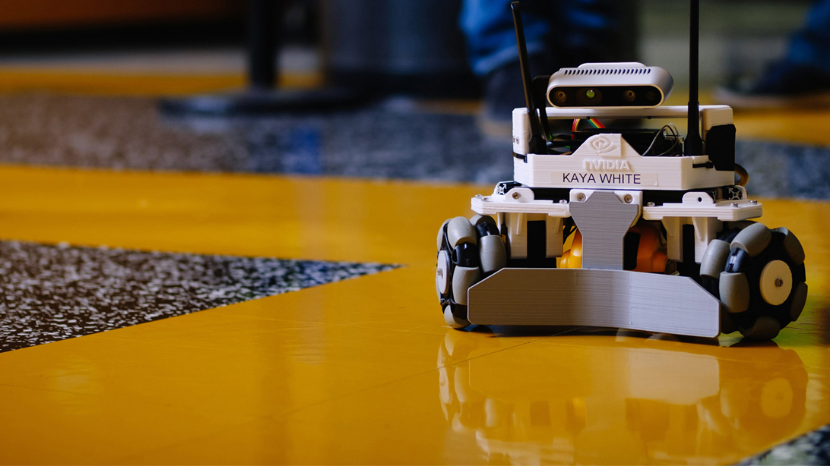

USE CASE STUDIES — EXAMPLE
Expand/shrink shaded gray box and text box based on amount of content
Move box and text based on image; avoid covering important components of visual
Line up partner logo to the baseline of NVIDIA logo and have same relevant sizing
Allow adequate spacing around content in relation to shaded gray box
Partner Logo Here

Slide 52
USE CASE STUDIES
Text goes here
Partner Logo Here

Slide 53
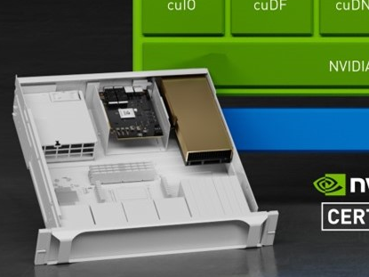
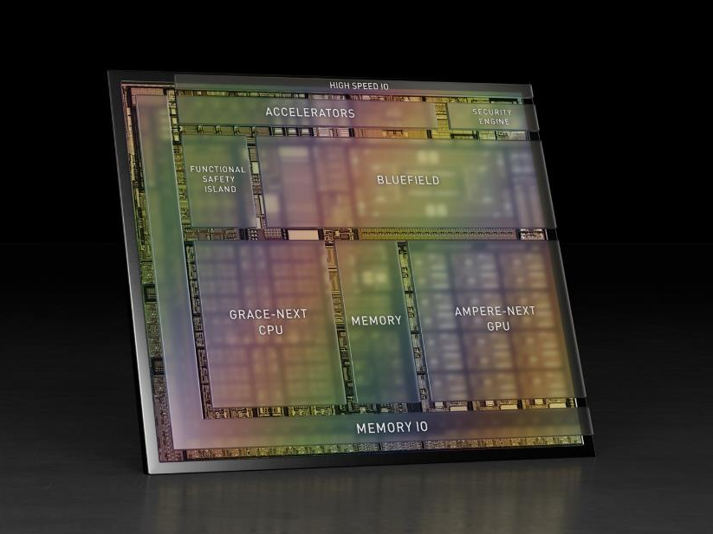
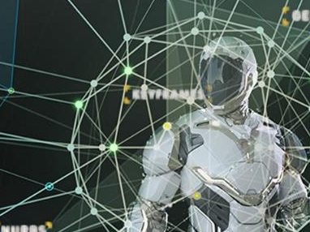
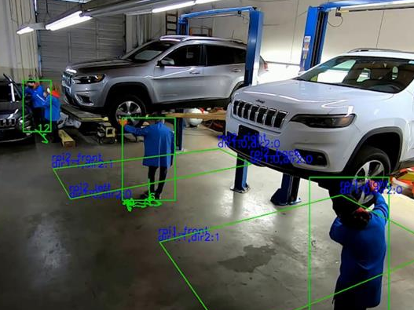
TIMELINE
With Images
TITLE GOES HERE
Supporting text here
TITLE GOES HERE
Supporting text here
TITLE GOES HERE
Supporting text here
TITLE GOES HERE
Supporting text here
2021
xxxx
xxxx
xxxx

Slide 54
COMPLEX TIMELINE
With Text
TEXT GOES HERE
Text goes here
TEXT GOES HERE
Text goes here
TEXT GOES HERE
Text goes here
TEXT GOES HERE
Text goes here
TEXT GOES HERE
Text goes here
TEXT GOES HERE
Text goes here
TEXT GOES HERE
Text goes here
Text goes here
Text
Text
Text
Text goes here
Text
Text
Text goes here
Text
Text
Text
Text
Text goes here
Text
Text
Text
Text
Text goes here
Text
Text
Text
Text
Text goes here
Text
Text
Text
Text
Sept. 2021
Oct.
Nov.
Dec.
Jan. 2022
Feb.
Mar.
Text
Text
Text
Text

Slide 55
VIDEO/DEMO TITLE

Slide 56

World map
Adjust Locations to Areas Desired
Helsinki
Santa Clara
Tokyo

Slide 57
assets

Slide 58
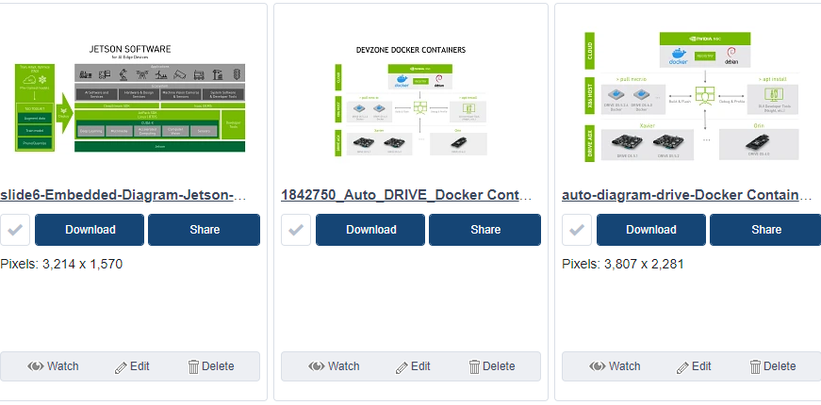
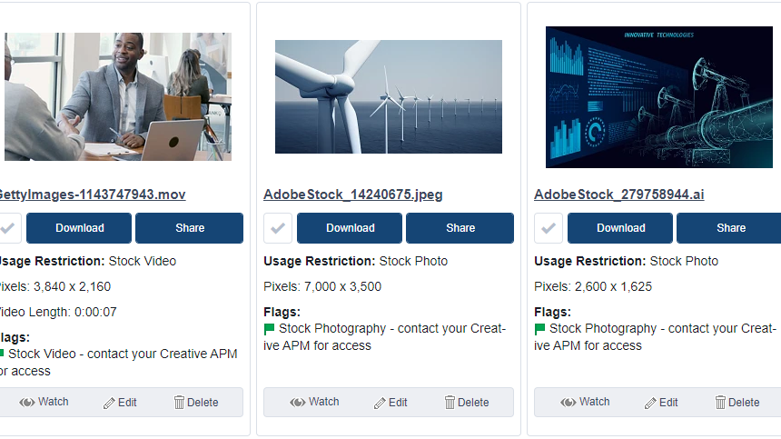
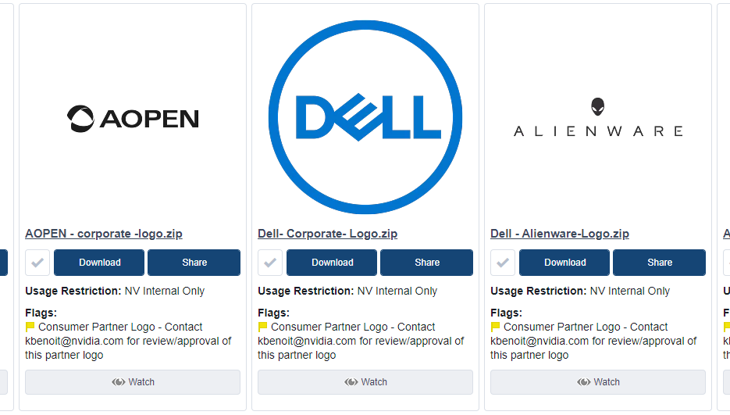
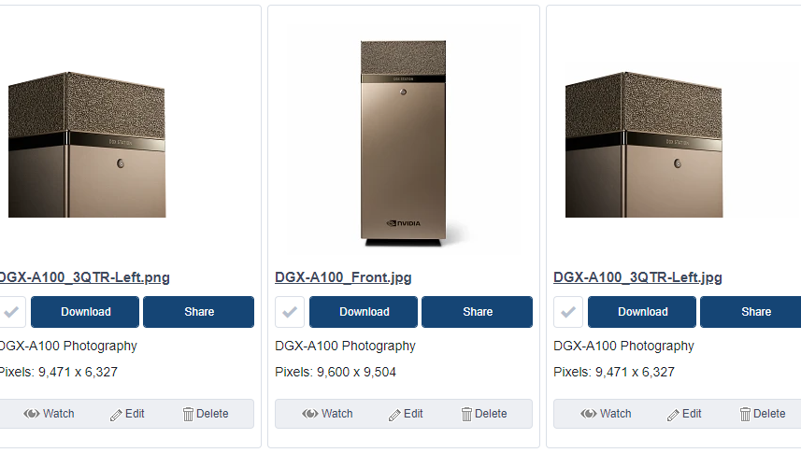
Images, Assets AND LOGOS
Available for Download at: NVDAM

Slide 59

Icons and Ampersands
ICON LIBRARY
AMPERSANDS
Available for Download at: NVDAM Icon Library
Change Ampersand from Trebuchet to Arial
&
&
Trebuchet
Arial

